Slide 1


Slide 2
Agenda
Last class we set the SVM Primal problem
This class we turn our attention to how to solve this problem
Also we will study what is soft SVM and how to solve this probelm

Slide 3
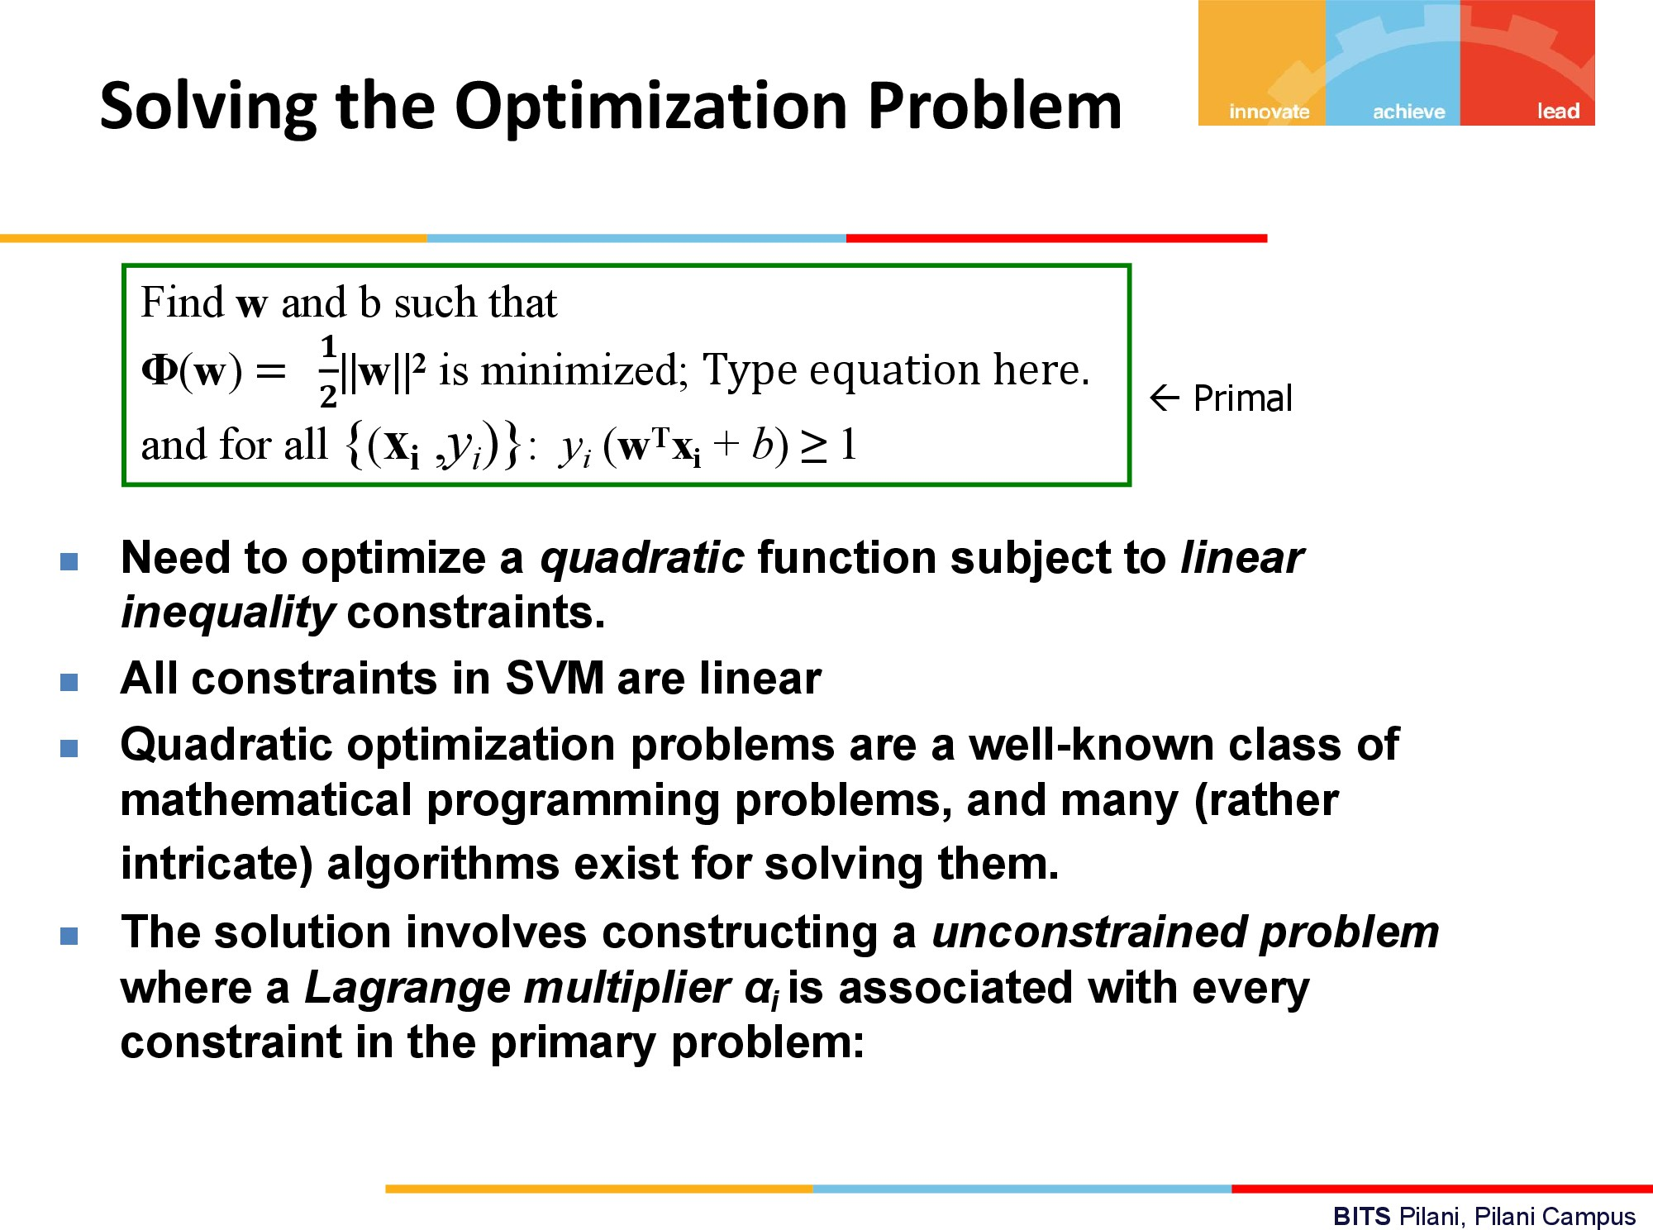

Slide 4
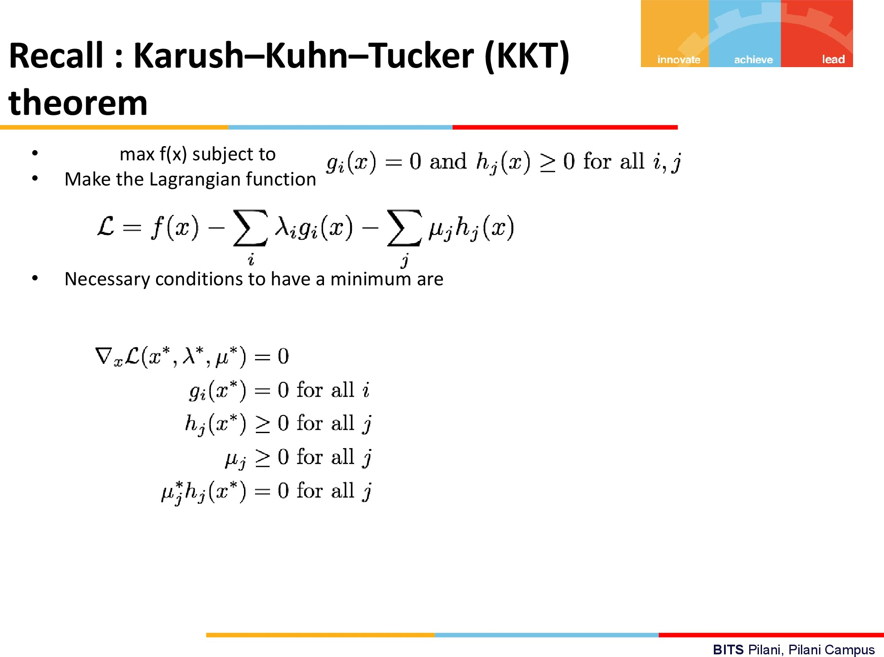

Slide 5
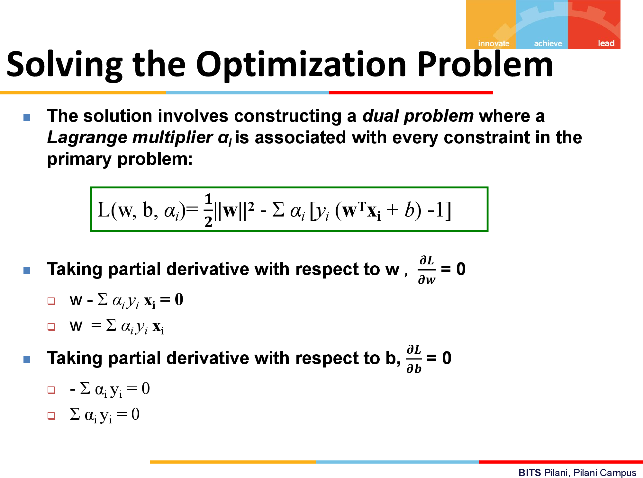

Slide 6
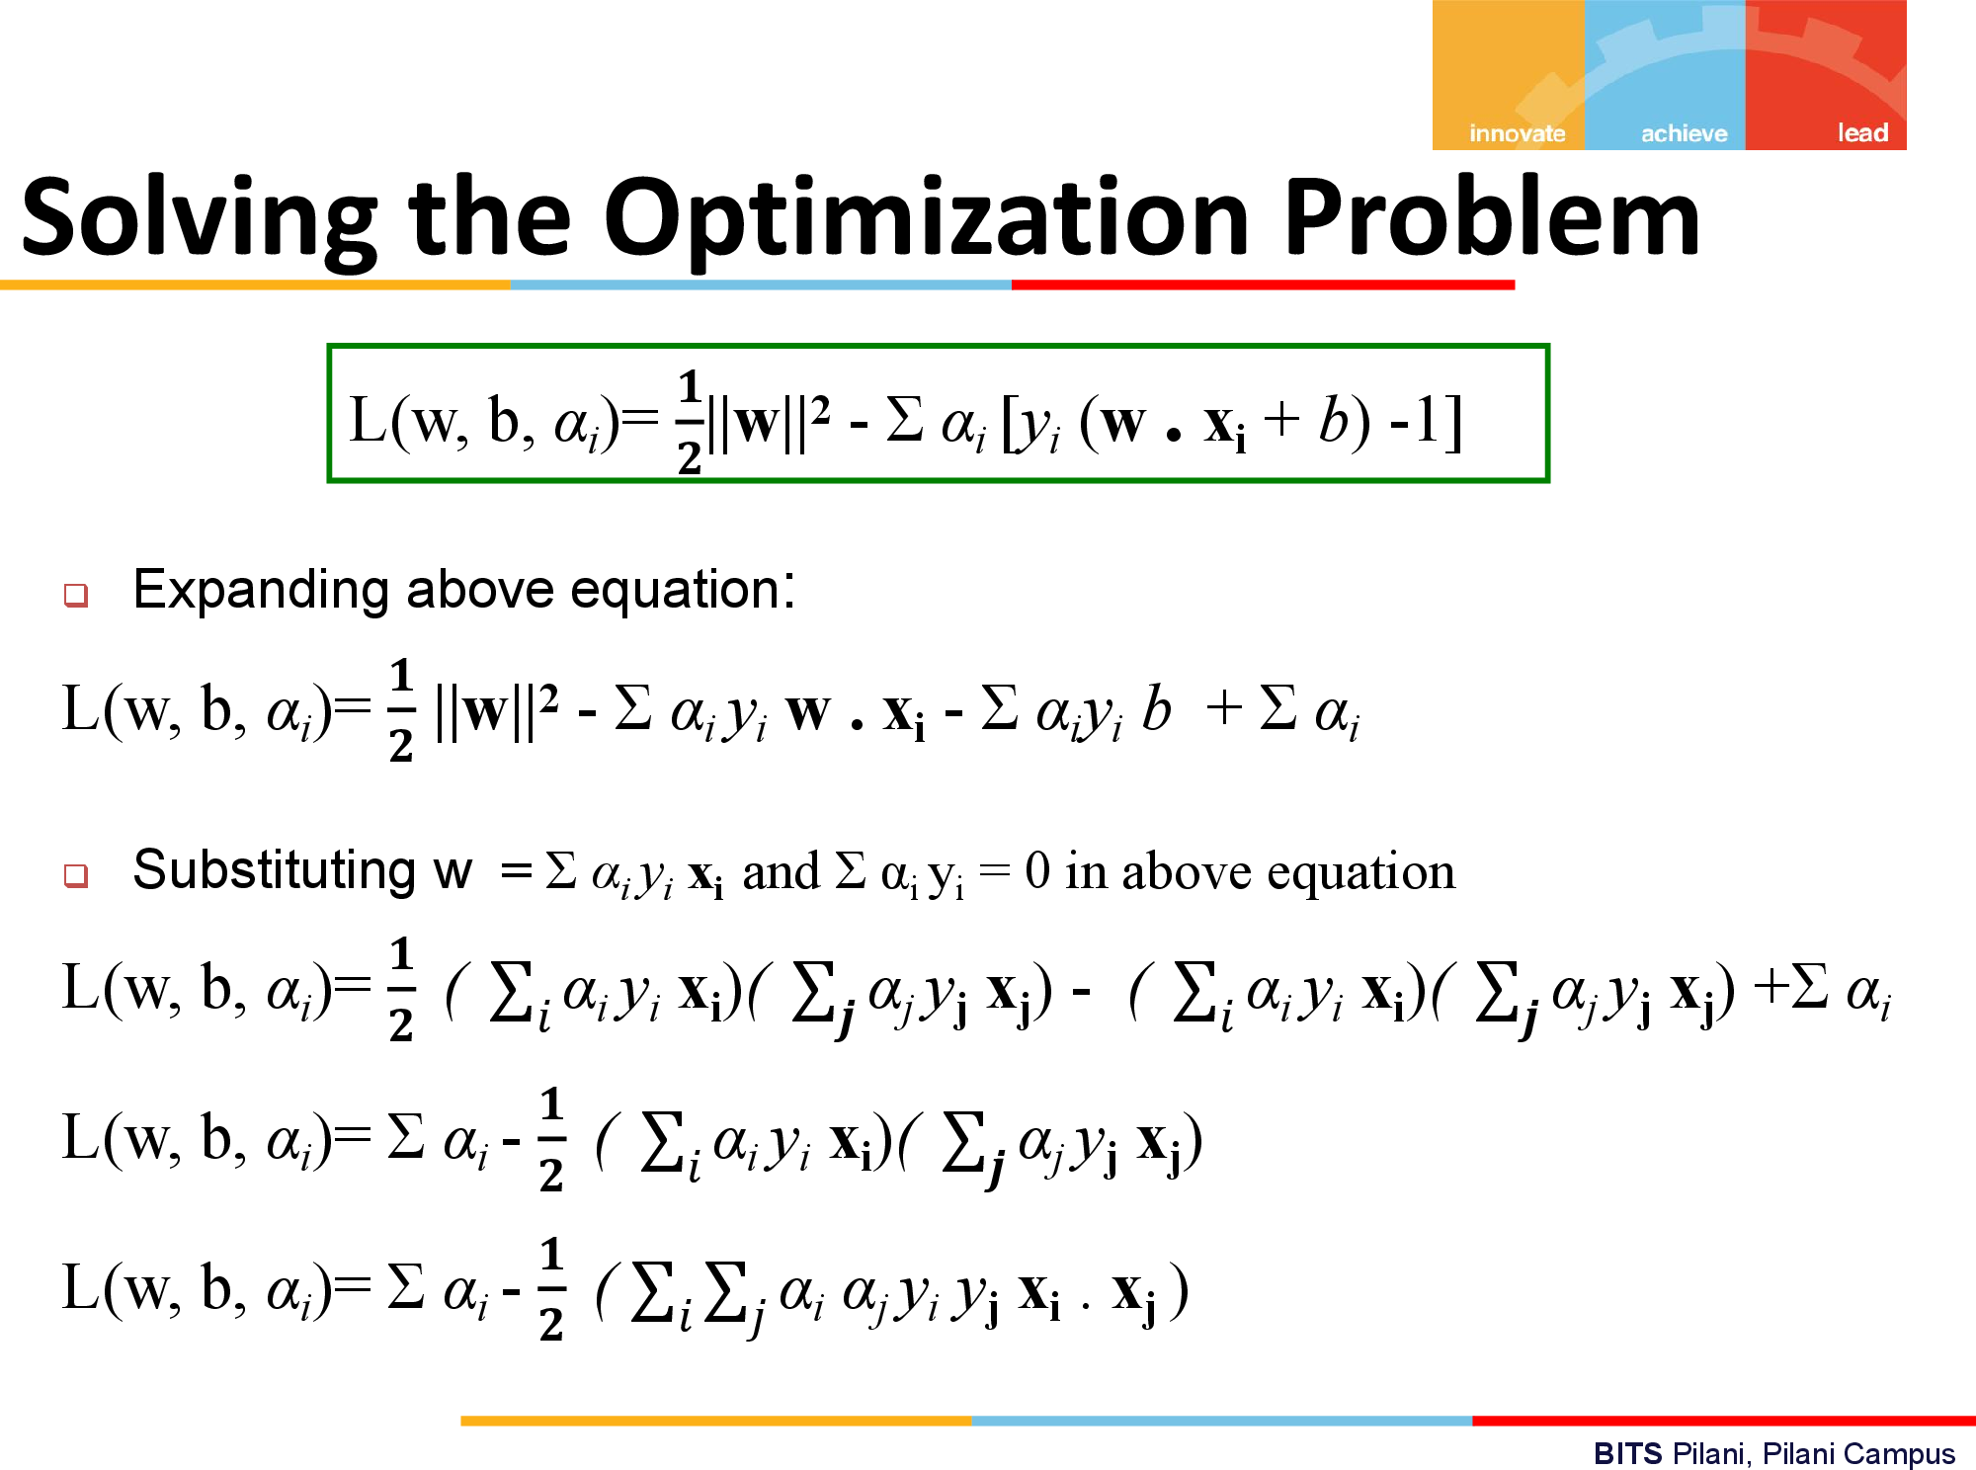

Slide 7
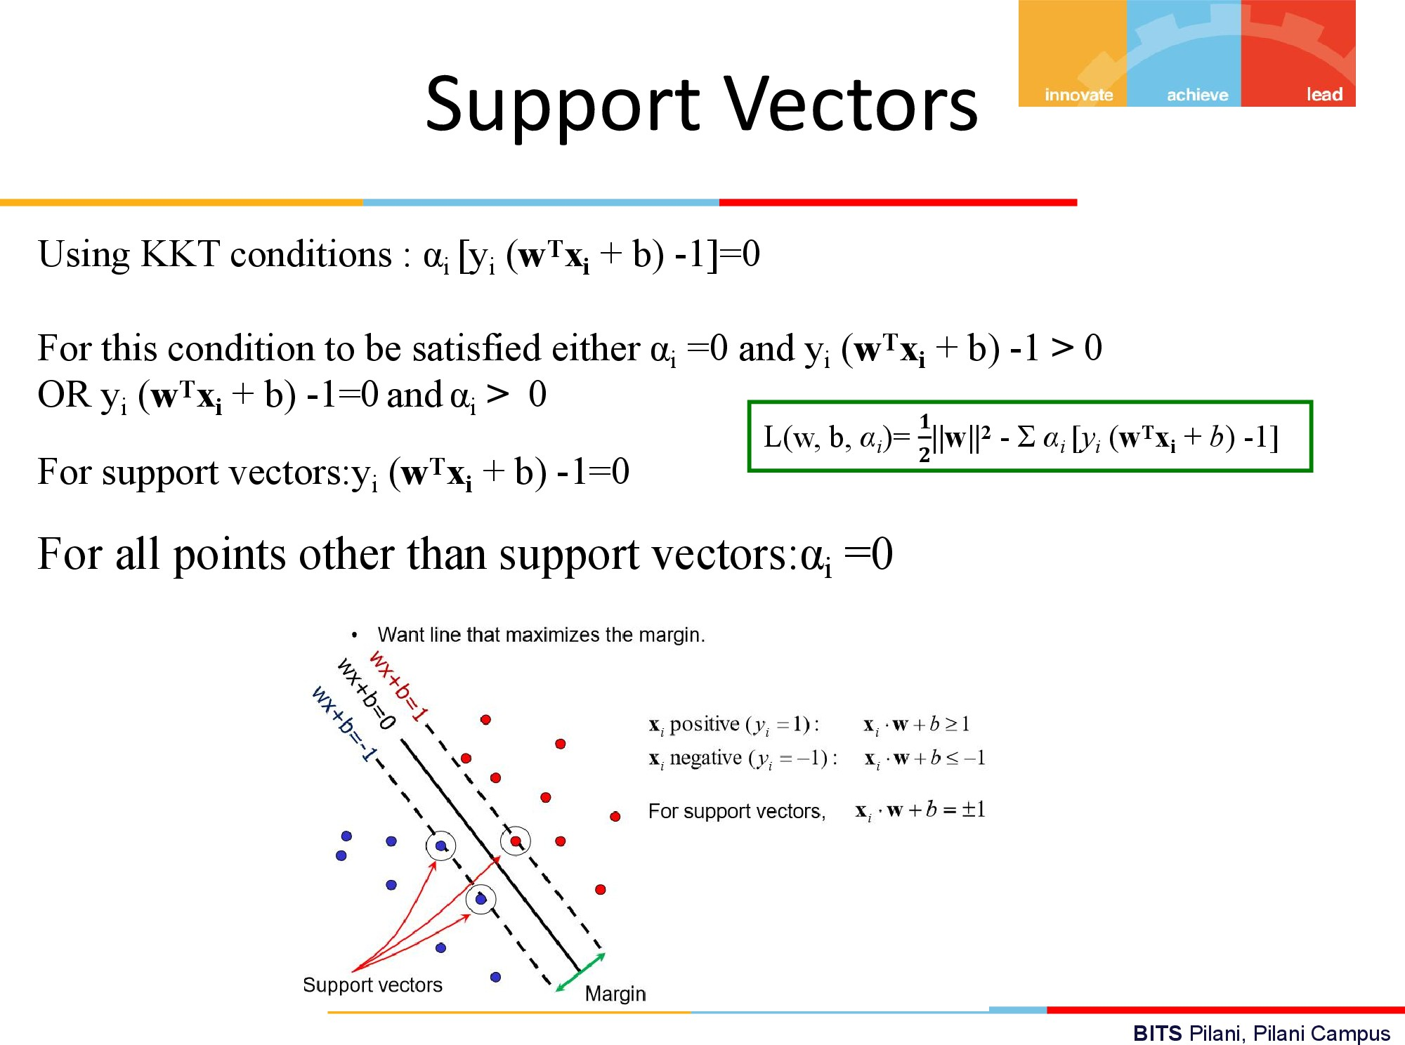

Slide 8
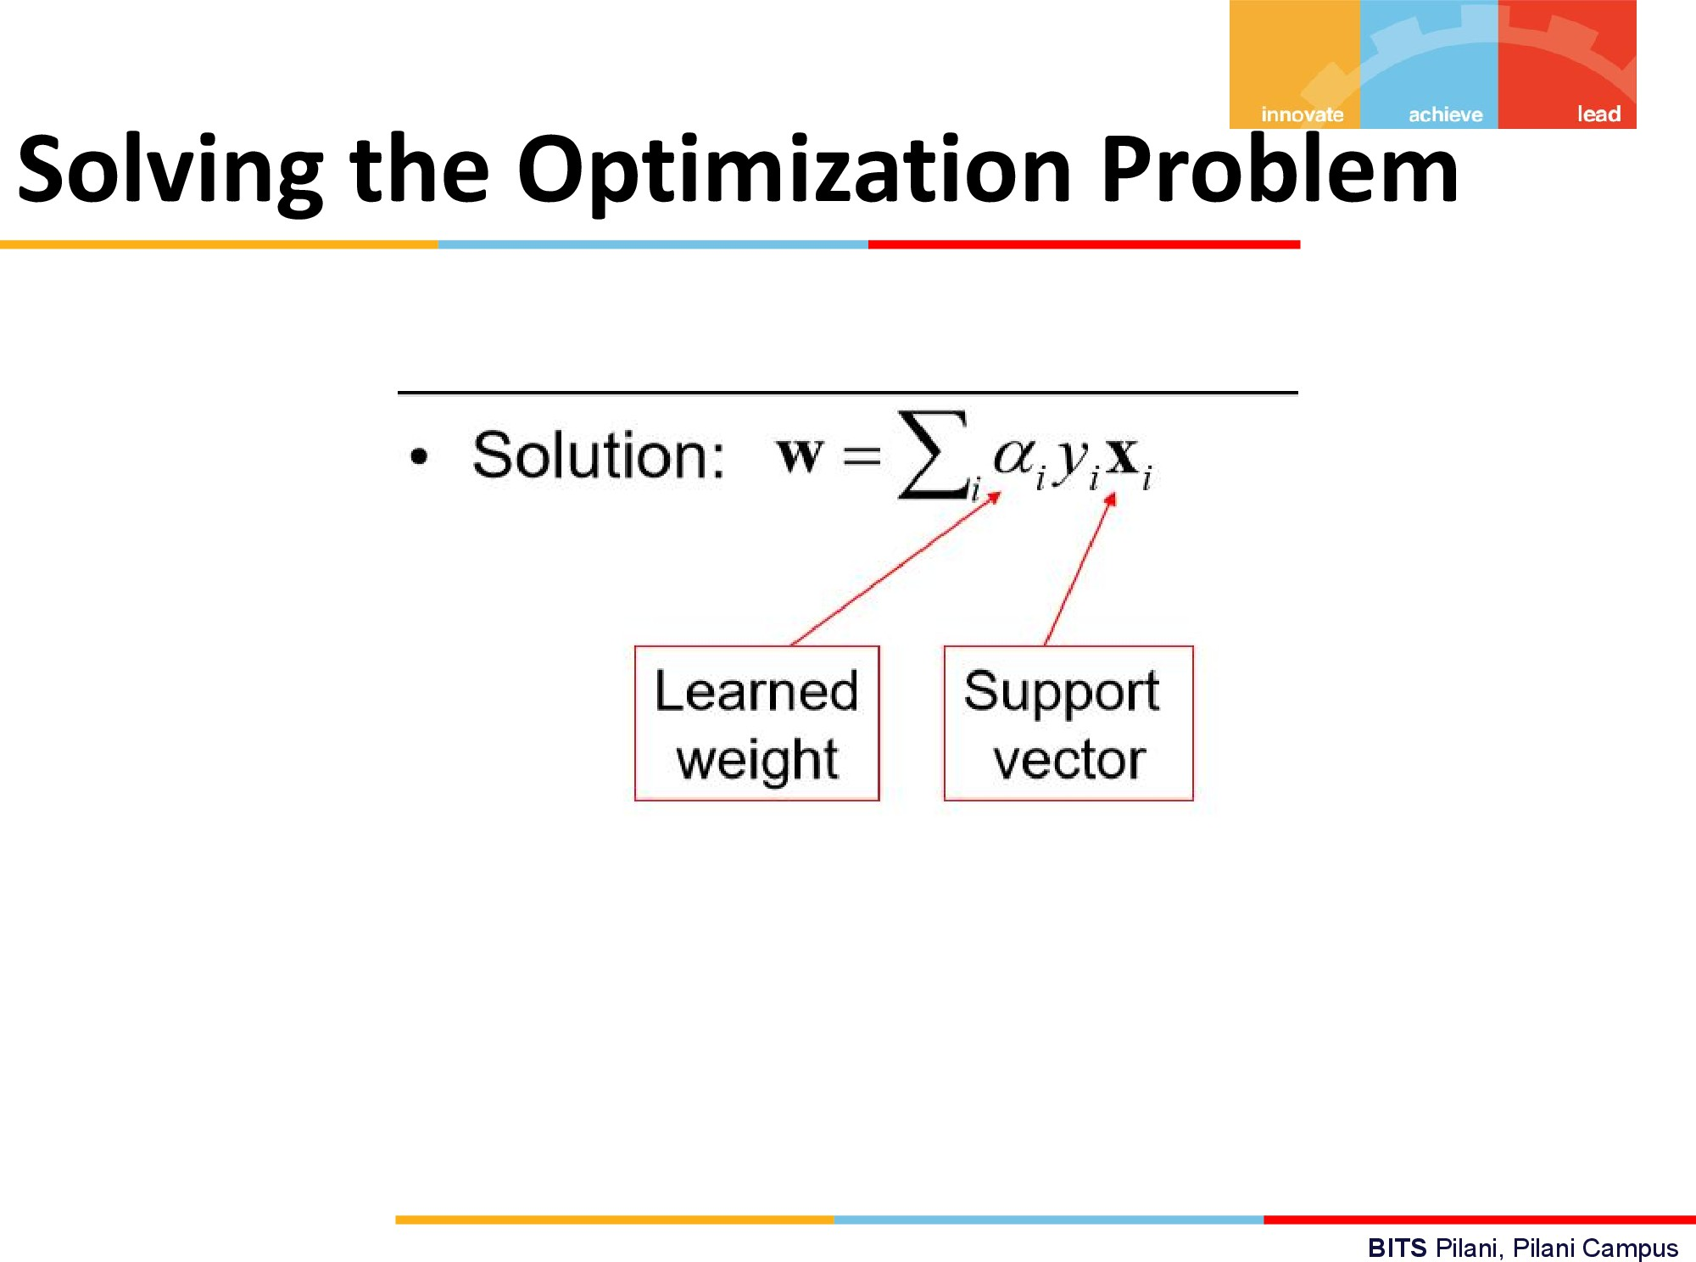

Slide 9
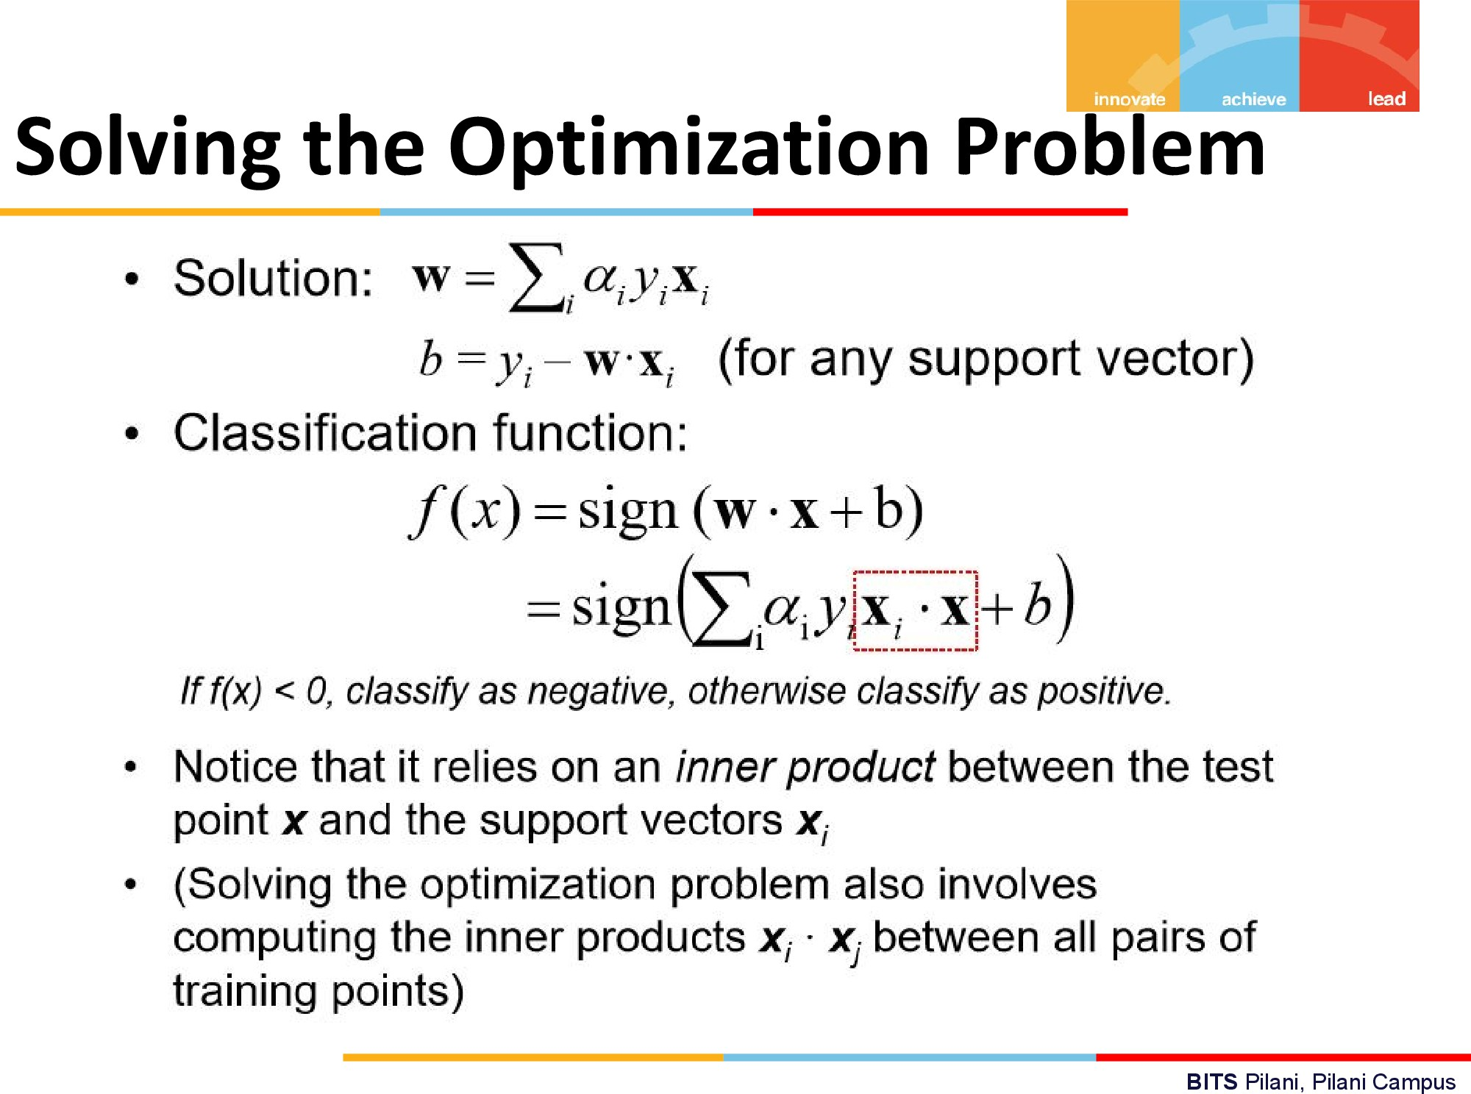

Slide 10
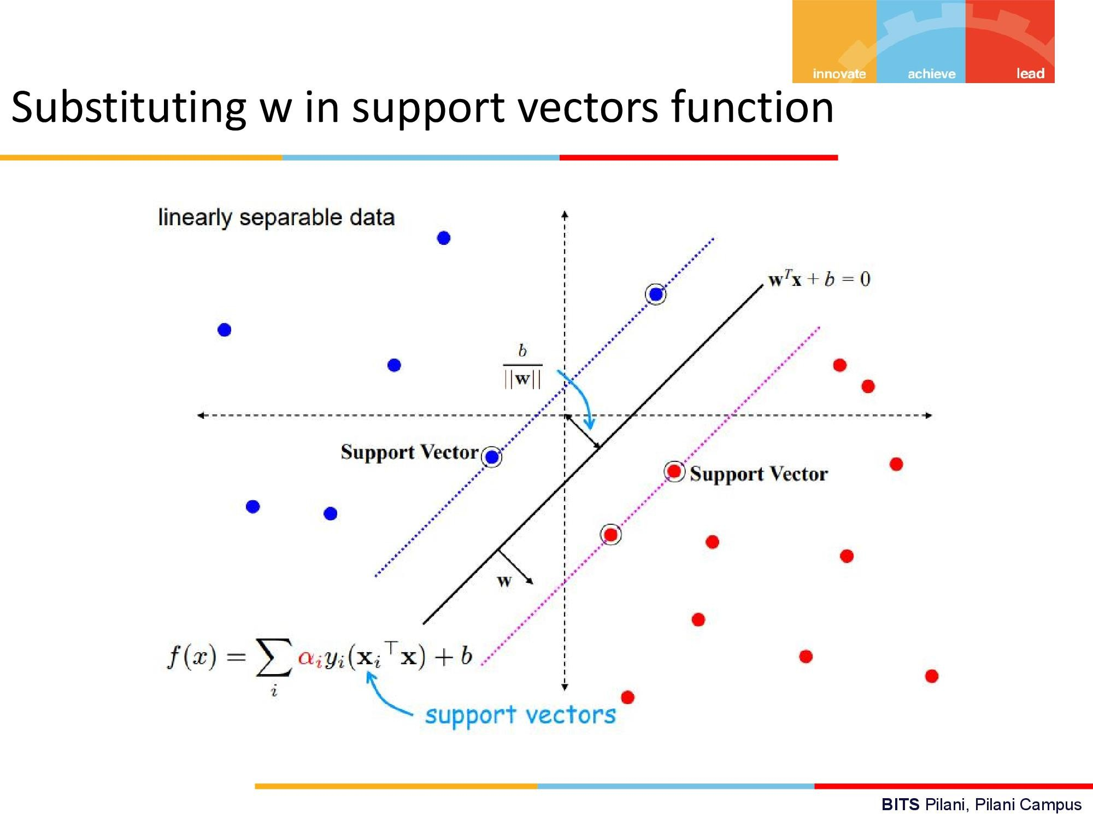

Slide 11
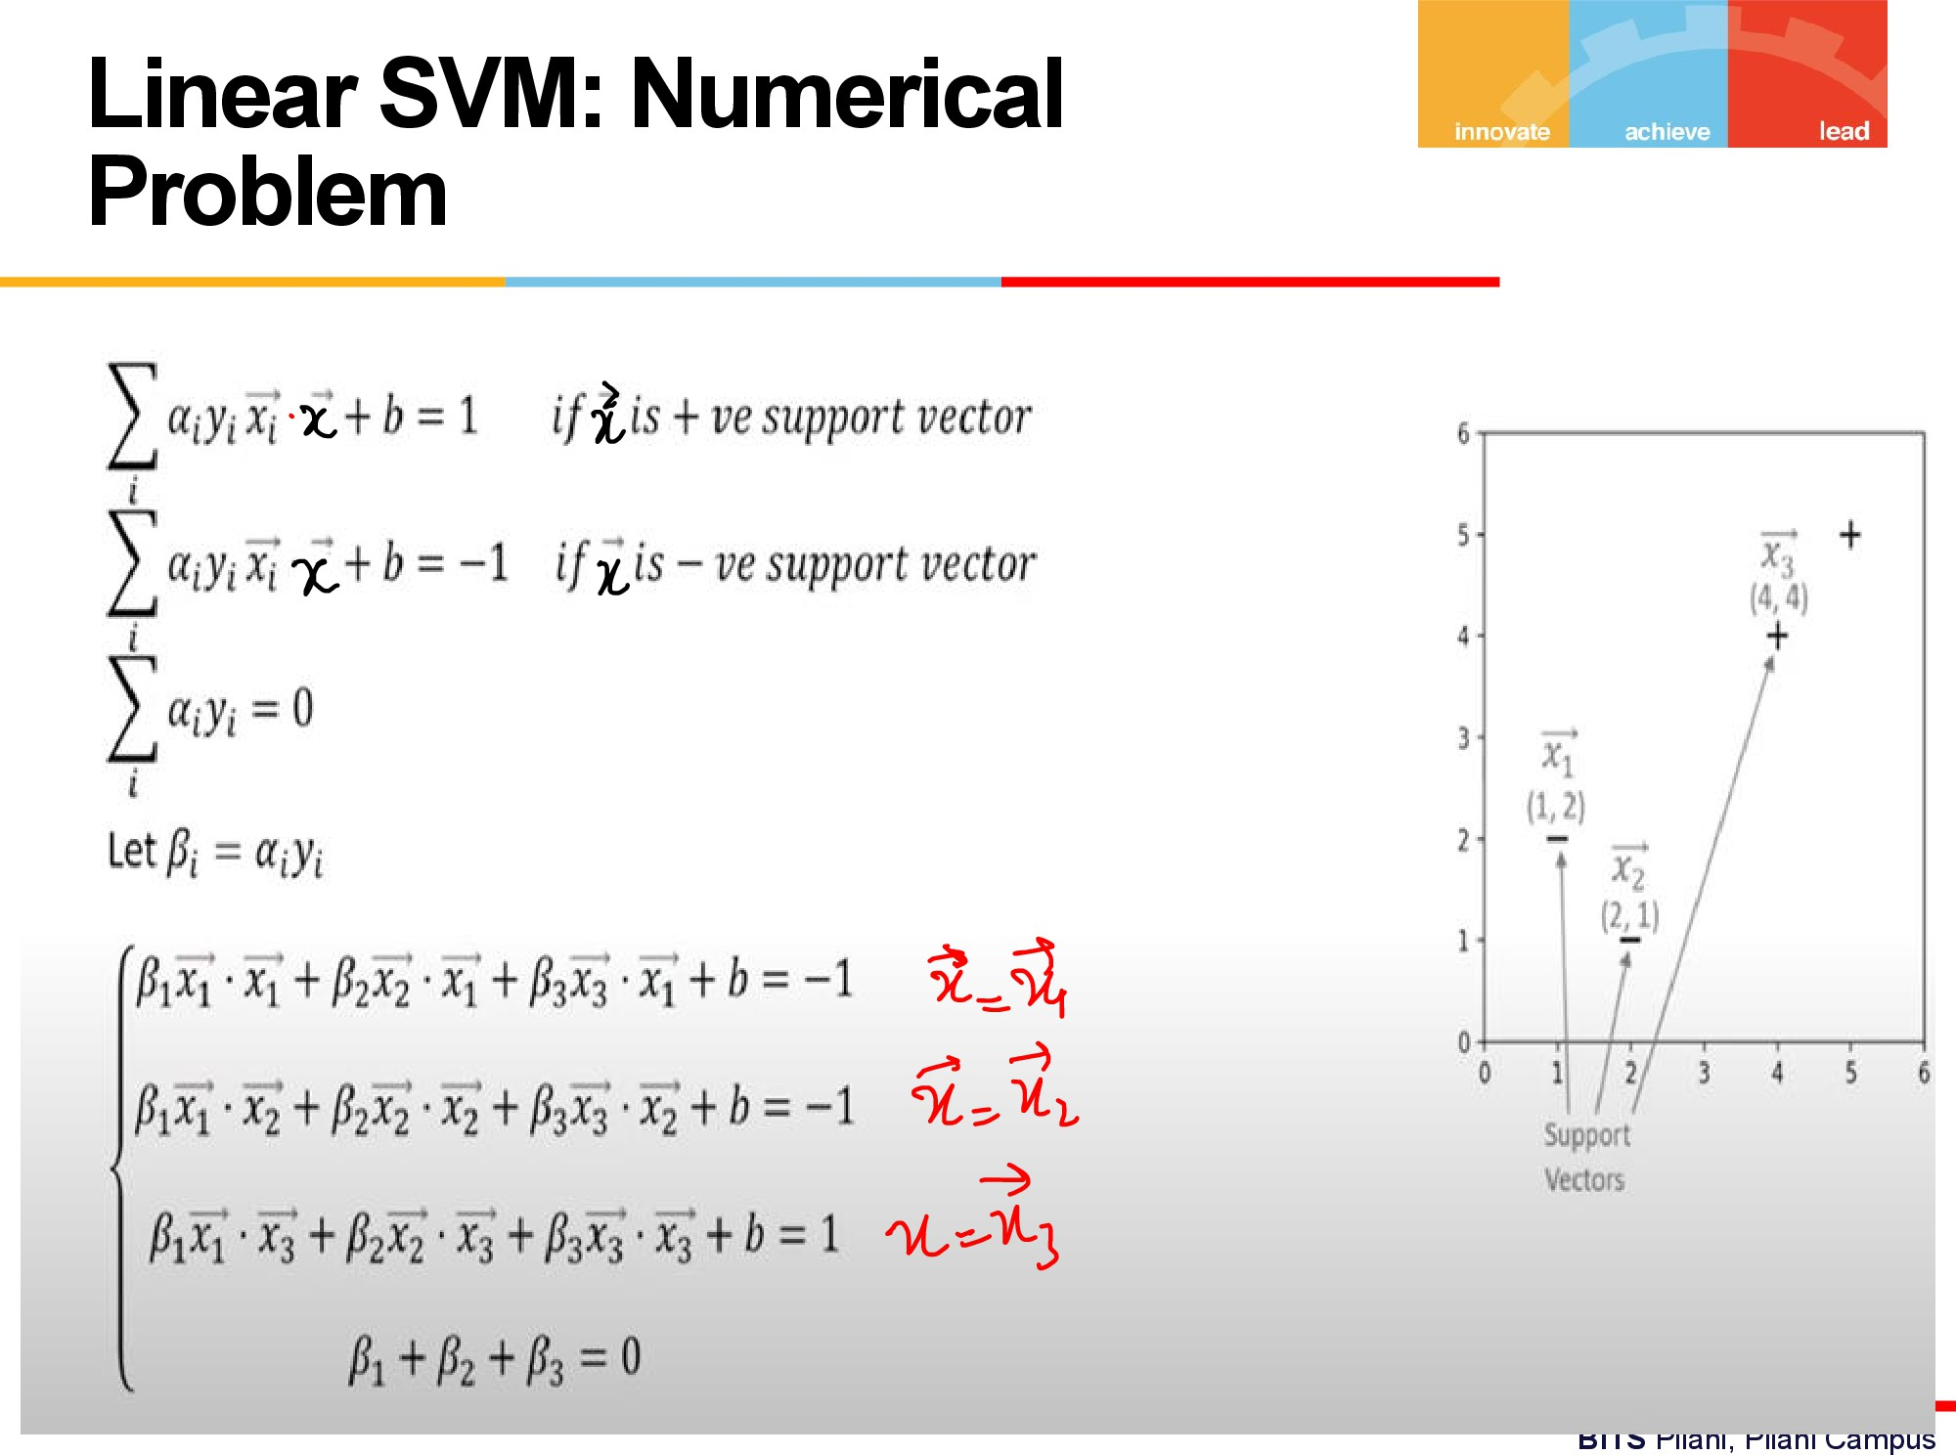

Slide 12
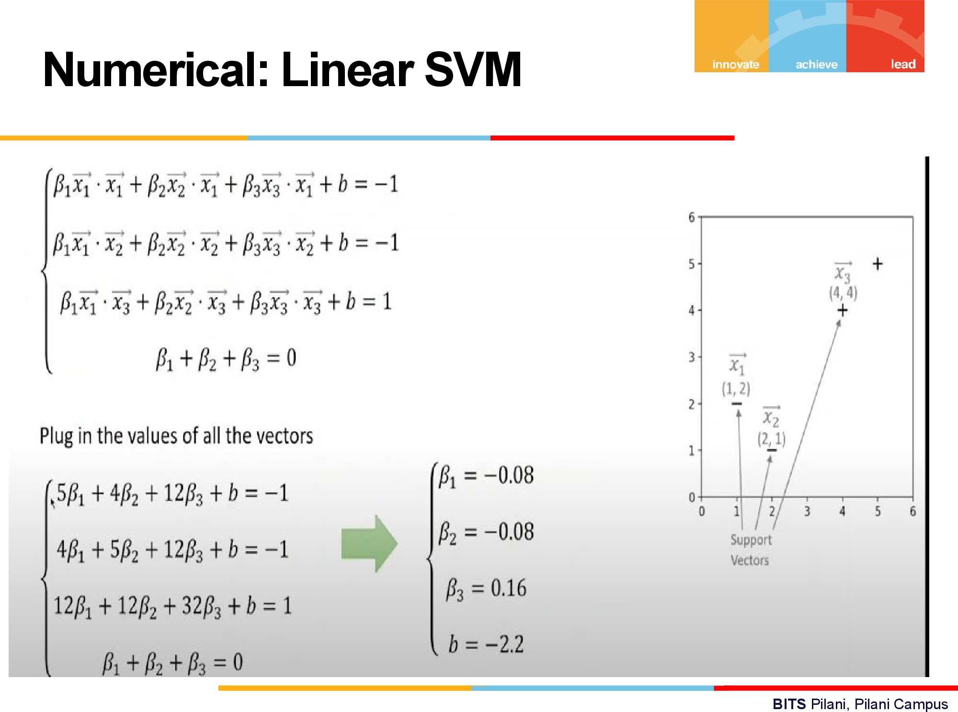

Slide 13
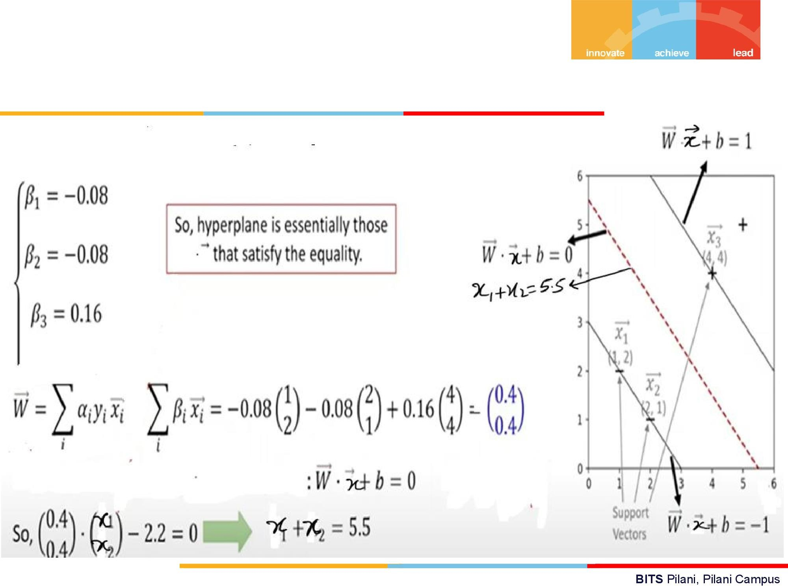

Slide 14
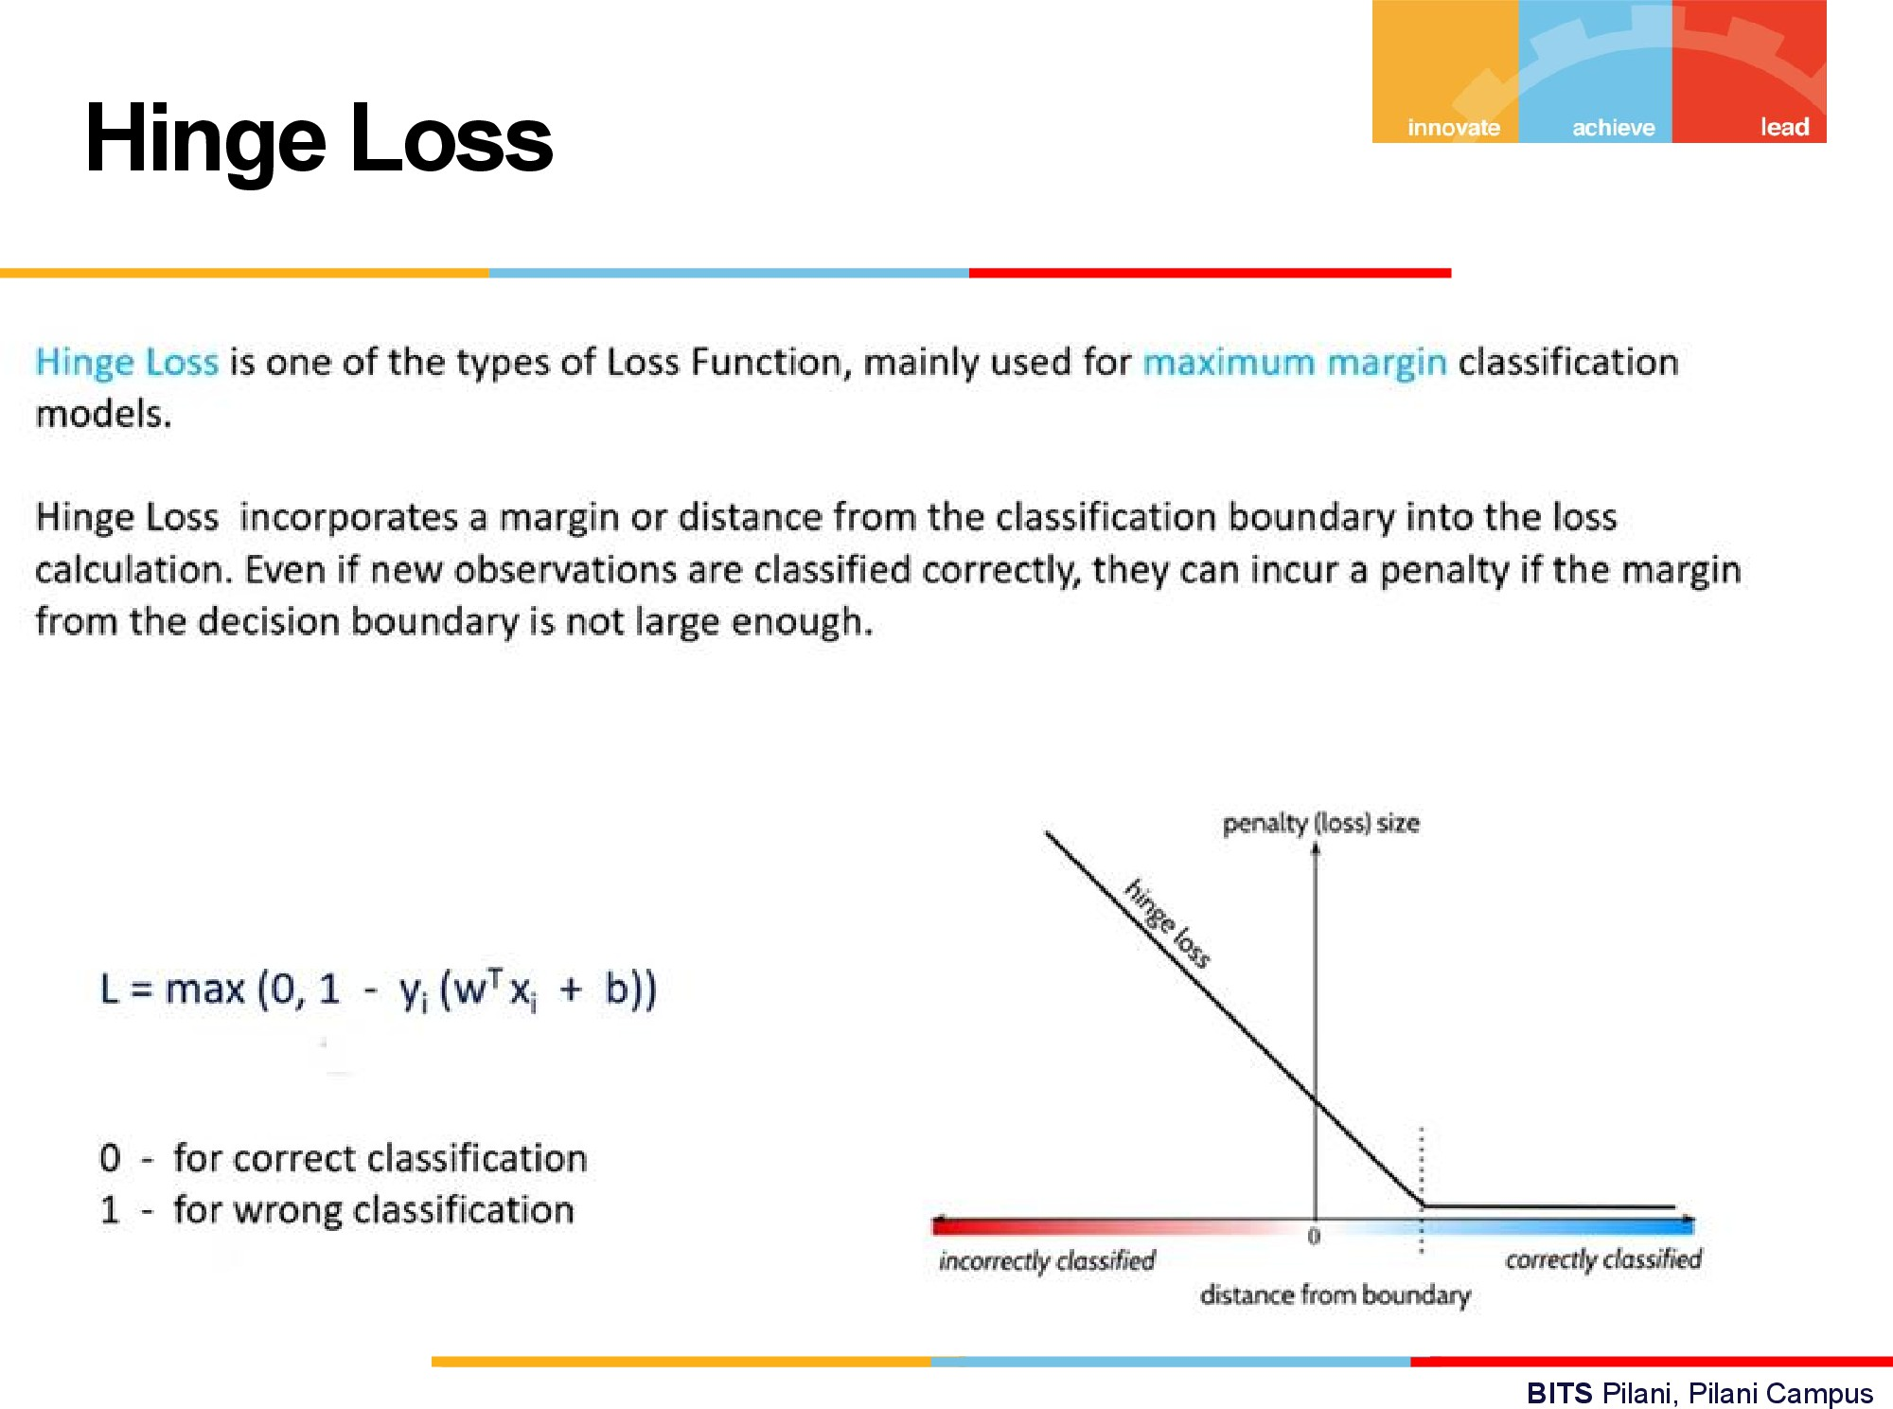

Slide 15
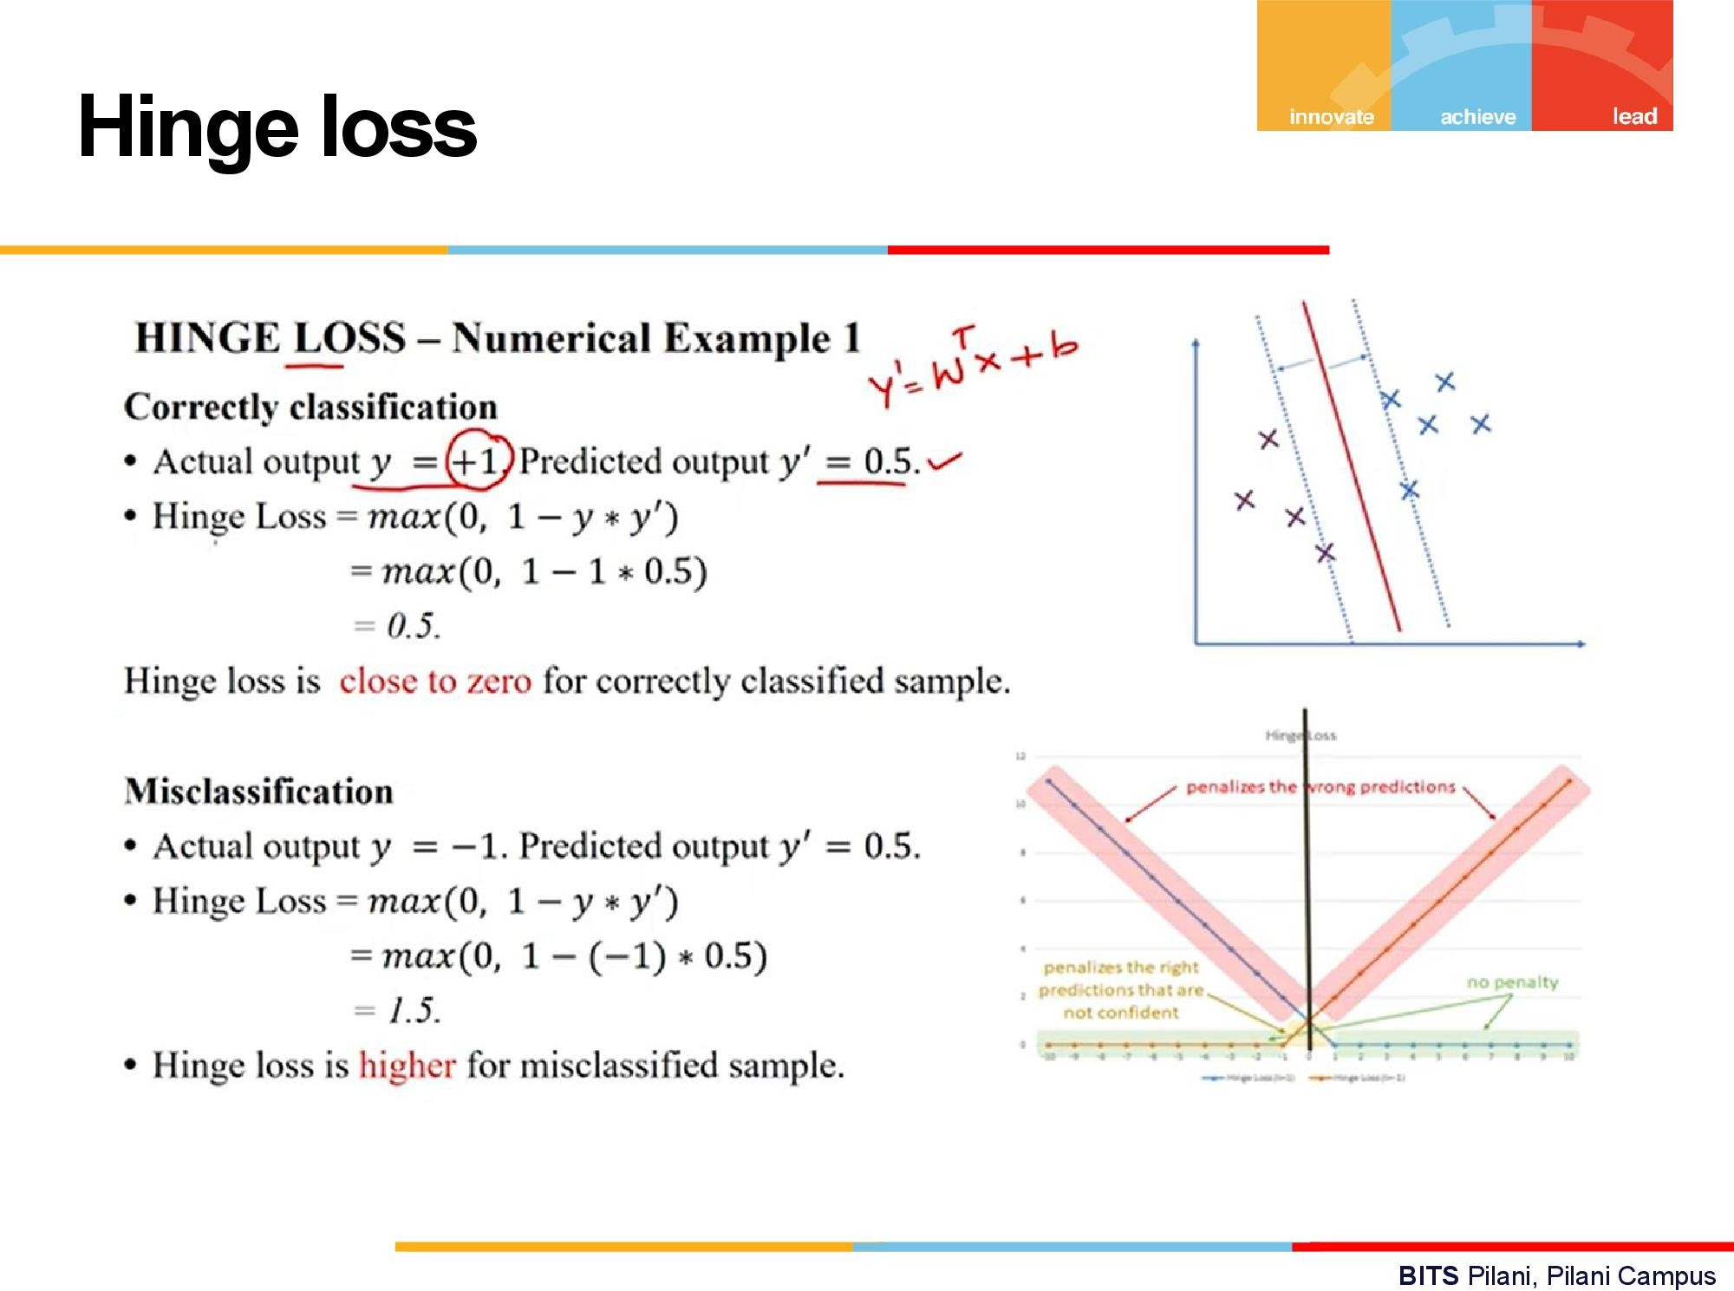

Slide 16
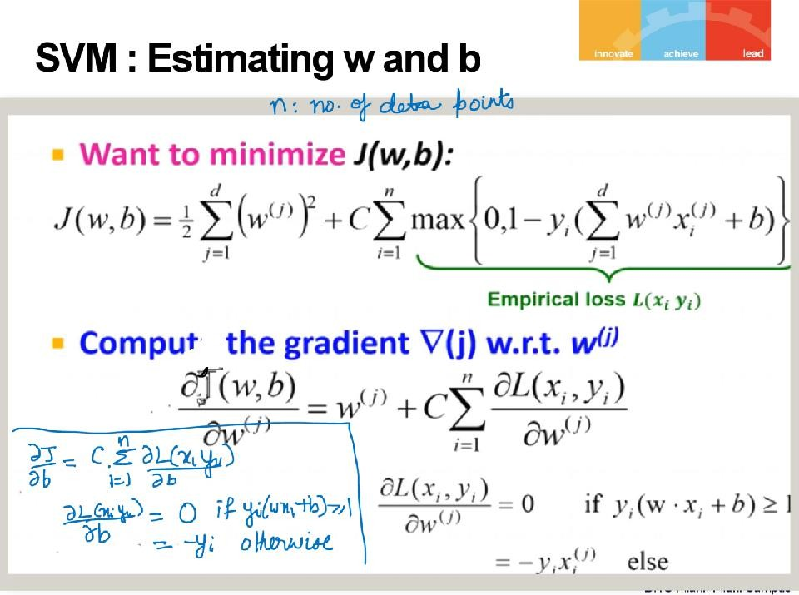

Slide 17
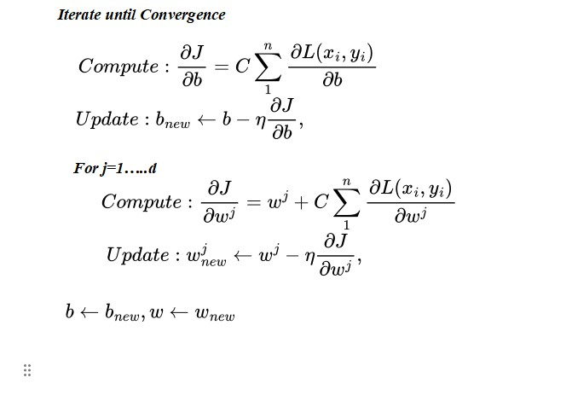
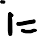
Gradient Descent

Slide 18
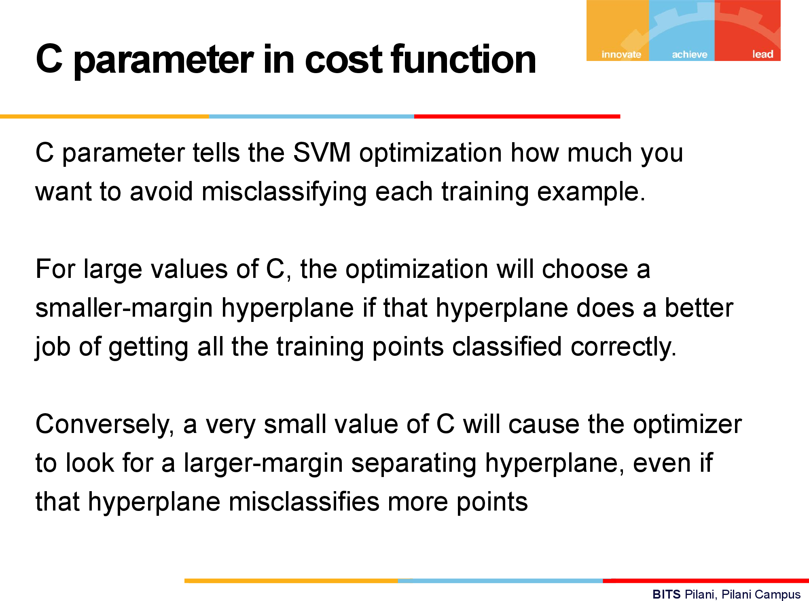

Slide 19
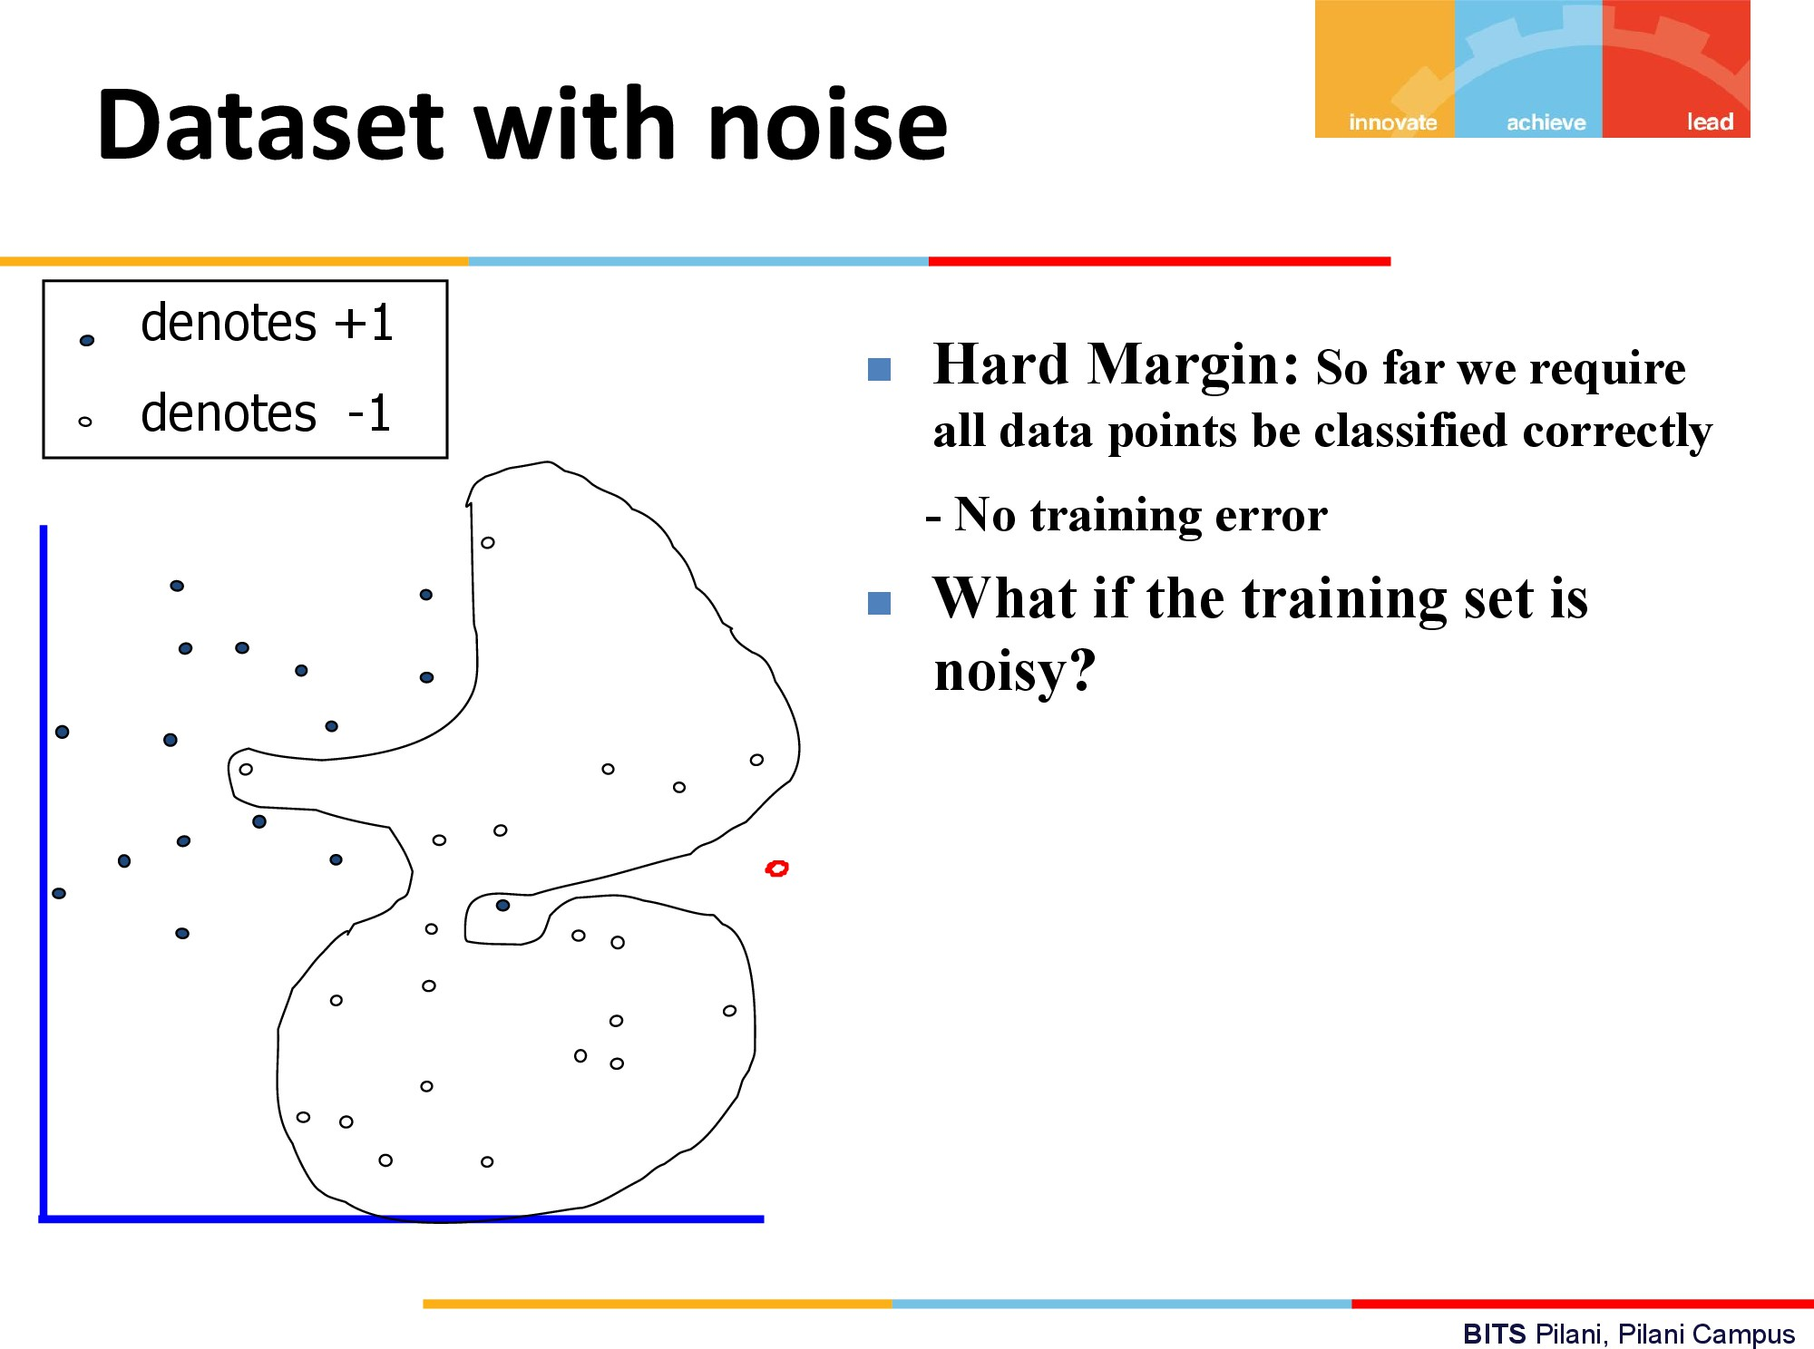

Slide 20
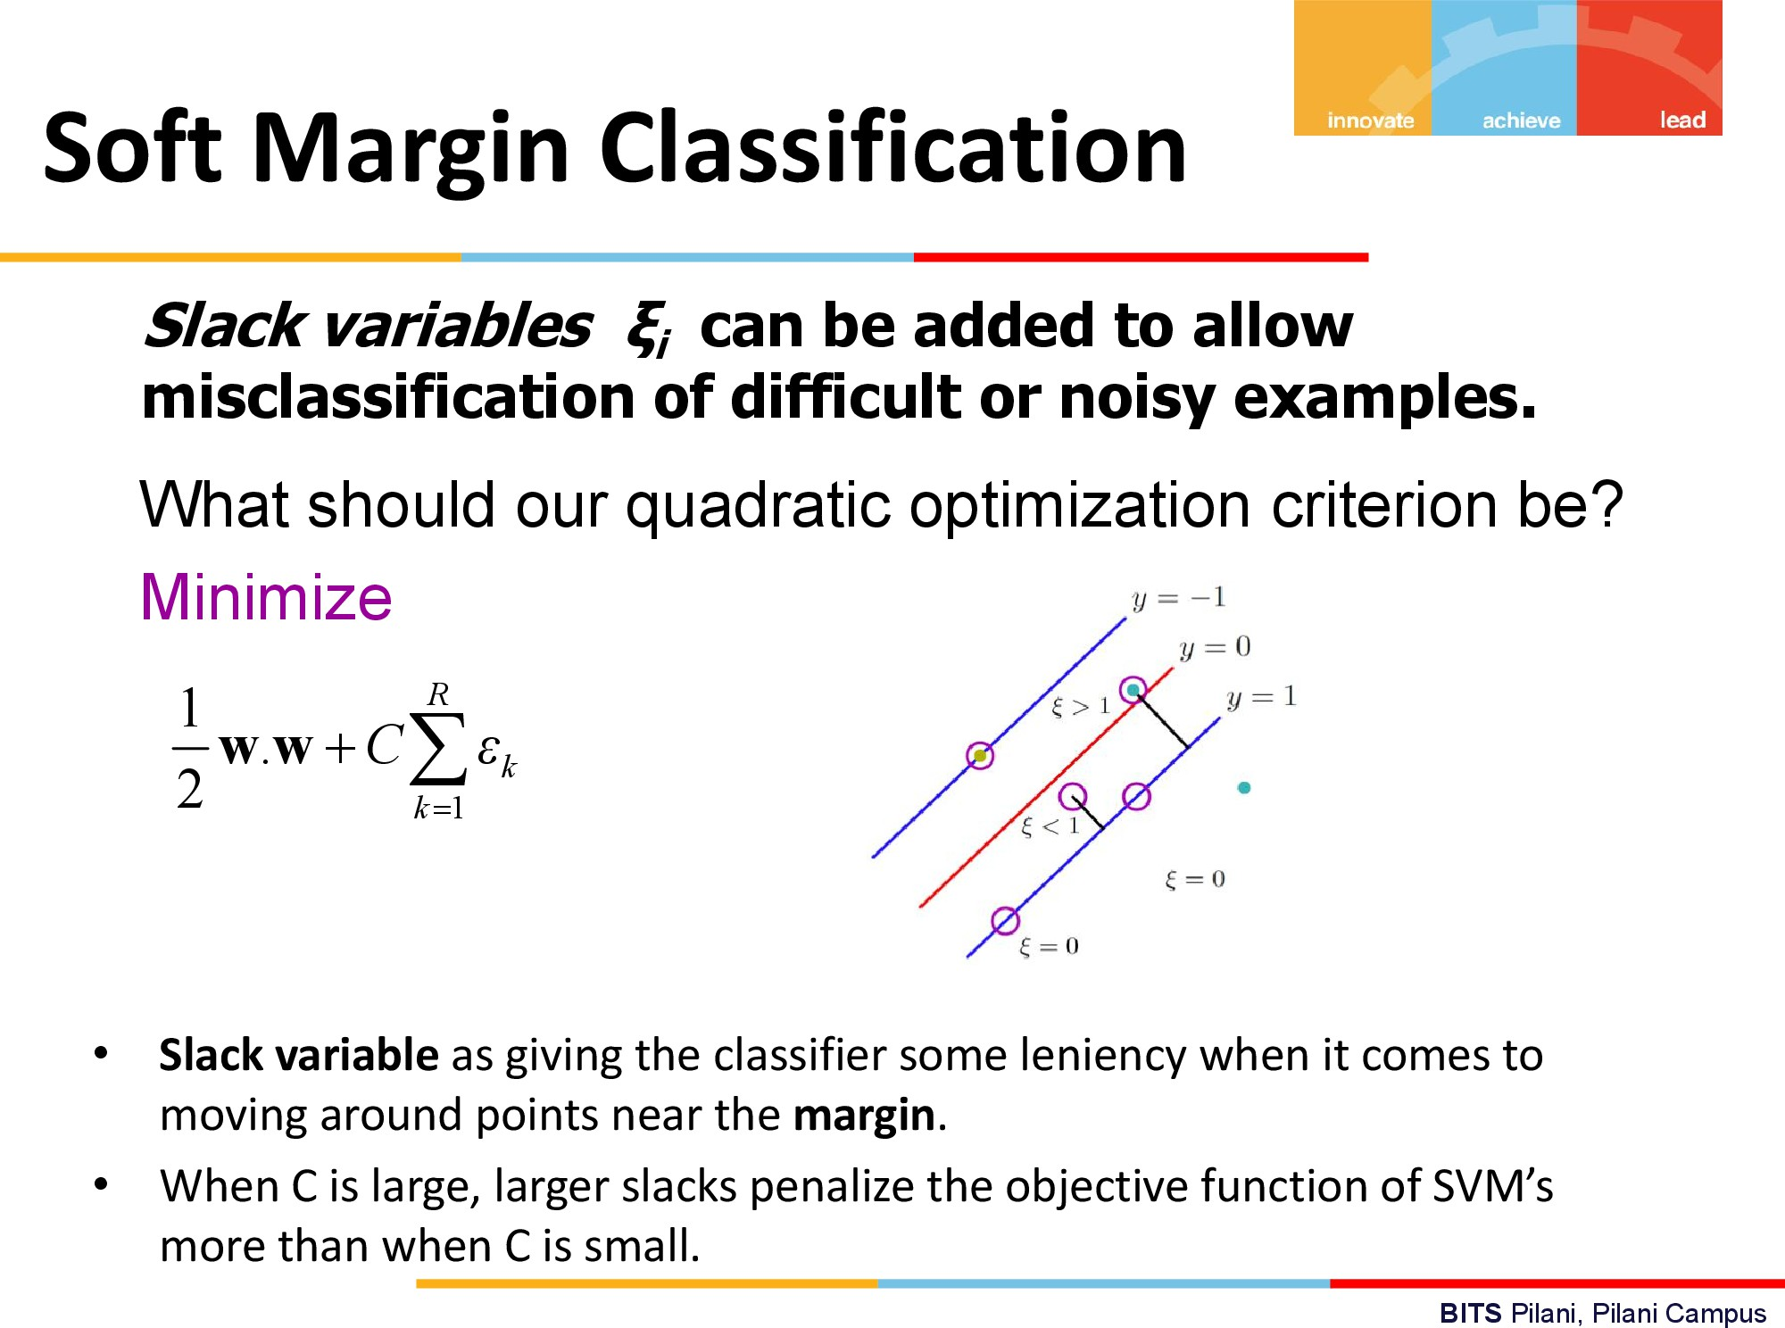

Slide 21
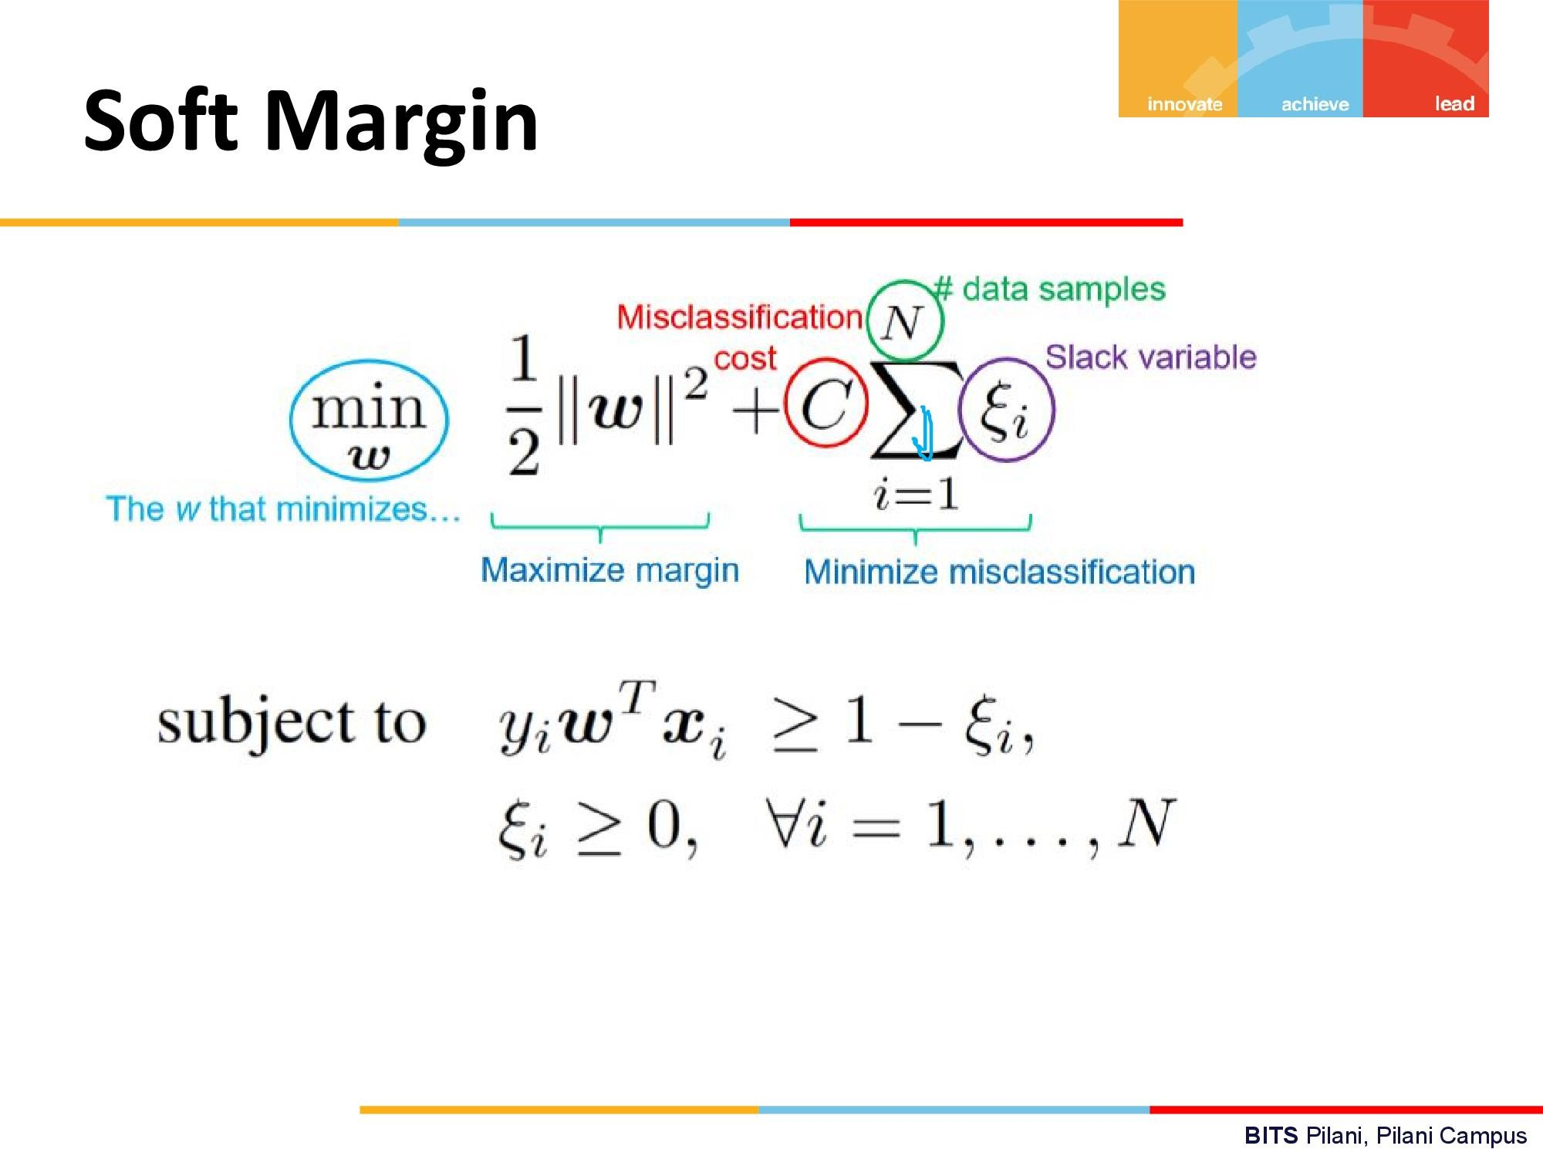

Slide 22
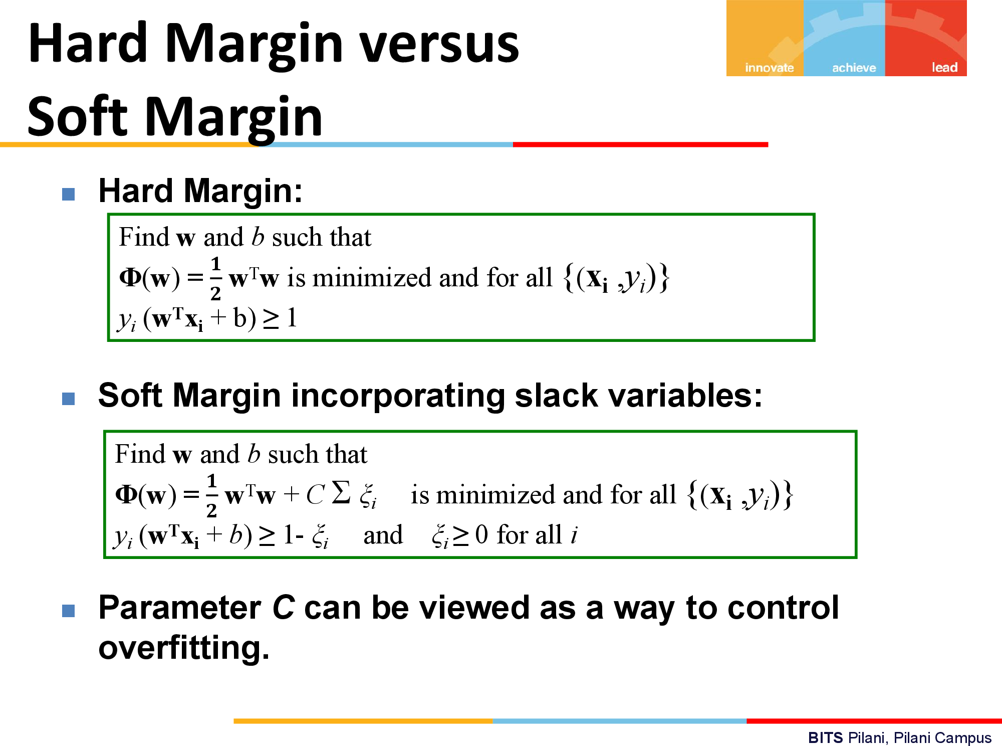

Slide 23
Given a set of 2D points {(1, 2), (2, 3), (3, 1), (4, 4) formulate the optimization problem for Support Vector Machine (SVM) algorithm with a soft margin, where the regularization parameter C = 0.5 and the kernel is linear. Assume that the points (1, 2) and (3, 1) belong to one class, and the points (2, 3) and (4, 4) belong to another class.
First we formulate the optimization problem.

Slide 24
To calculate the optimal hyperplane using the Support Vector Machine (SVM) algorithm, we first need to understand that the goal is to find the weights (w) and bias (b) that maximize the margin between the two classes, given the regularization parameter C = 0.5 and a linear kernel.
The points (1, 2) and (3, 1) belong to one class, which we can denote as class A with label y = -1, and the points (2, 3) and (4, 4) belong to another class, denoted as class B with label y = 1.
Formulation
Given the linear kernel, the decision boundary (hyperplane) can be represented as w^{T} x + b = 0, where w is the weight vector, x is the input vector, and b is the bias. For a 2D space, w = [w₁, w₂], x = [x₁, x₂], and the equation becomes w₁ x₁ + w₂x₂ + b = 0.

Slide 25
Solution
We need to solve the optimization problem that maximizes the margin, which is formulated as:
Minimize: (1/2) * w^{T} * w + C * Σξ_{i}
Subject to:
y_{i} (w^T * x_{i} + b) ≥ 1 – ξ_{i}
where ξ_{i} are slack variables introduced for the soft margin, and the sum is over all training examples.
Calculation
Let's assign the labels and calculate:
For (1, 2), y = -1
For (2, 3), y = 1
For (3, 1), y = -1
For (4, 4), y = 1
Using a linear kernel and considering the soft margin, we aim to find w and b that satisfy the constraints with minimal violation (ξ_{i}).

Slide 26
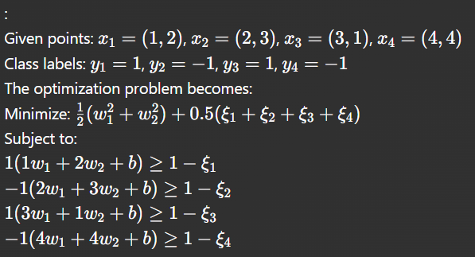
Solving this problem is little tedious.
You can run python code to solve this problem.
For your reference the python code and the ouputs are given in the following slides.

Slide 27
